Slide 1

Machine Learning Project on Ames House Price Data Set
INSAID: GCD: Term-3 Project by S.R.Uthayanan

Slide 2
Agenda
Problem Statement
Data Description
Data Exploration
Regression Models
Conclusions

Slide 3
Problem Statement
With 79 explanatory variables describing (almost) every aspect of residential homes in Ames, this project challenges to predict the Sale Price of each home.

Slide 4
Description of Dataset
Dataset info:
Number of variables: | 81
Number of observations: | 1460
Variables types:
Numeric : | 38
Categorical : | 43

Slide 5
Data Pre Processing
Missing Value Treatment
19 attributes have missing values
Reason | Variables | Imputation
More than 80% of missing values | Alley, PoolQC, Fence, MiscFeature | Dropped
Lack of Subject Described | No Basement No Garage No Fireplaces | Replaced with ‘None’.
Numerical variables with Less Missing Values | LotFrontage, MasVnrArea, GarageYrBlt | Replaced with Mean
Low Variance | Heating, RoofMatl, Condition2, Street and Utilities | Dropped

Slide 6
Data Exploration

Slide 7
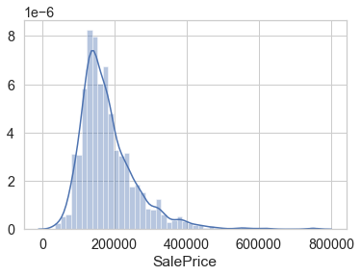
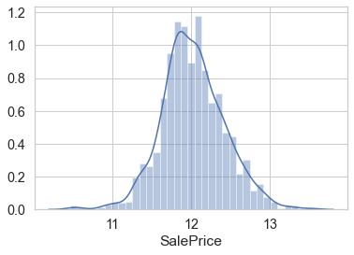
Distribution Target Variable(Sale Price)
Initial Distribution
After log Transformation
The target variable Sale Price is NOT normally distributed. This can reduce the performance of the ML Regression models.
Therefore we make a log transformation of Sale Price

Slide 8
Exploration of Numerical Features

Slide 9
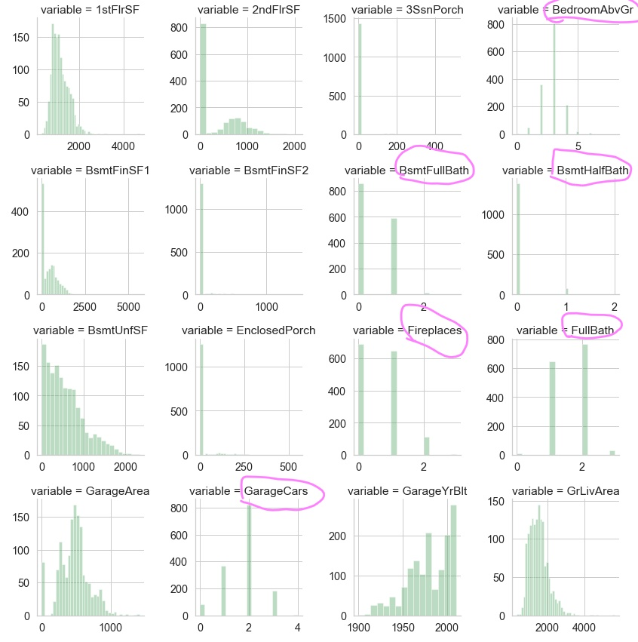
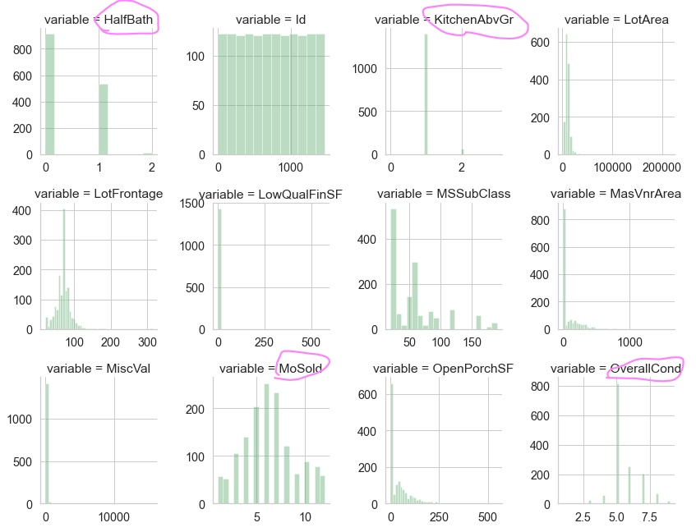
Distribution of Numerical Features

Slide 10
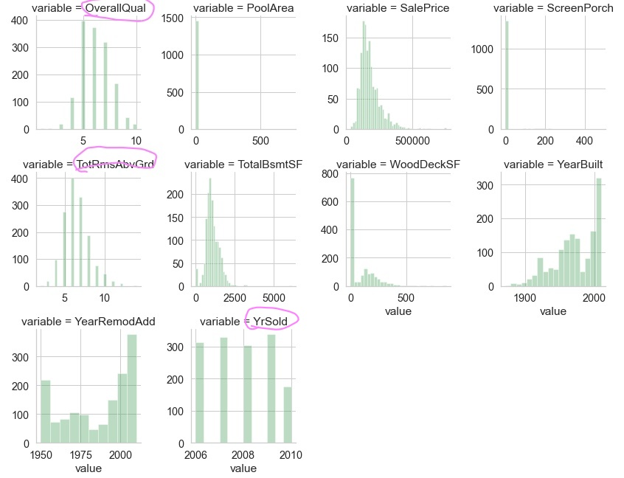
Distribution of Numerical Features
From these distribution Plots we can find the following 13 variable are DESCRETE values.
These variables need to be converted to Categorical Variables.
OverallQual, PoolArea,
OverallCond, BsmtFullBath,
BsmtHalfBath, FullBath,
HalfBath, BedroomAbvGr,
TotRmsAbvGrd, Fireplaces, GarageCars, MoSold, YrSold

Slide 11
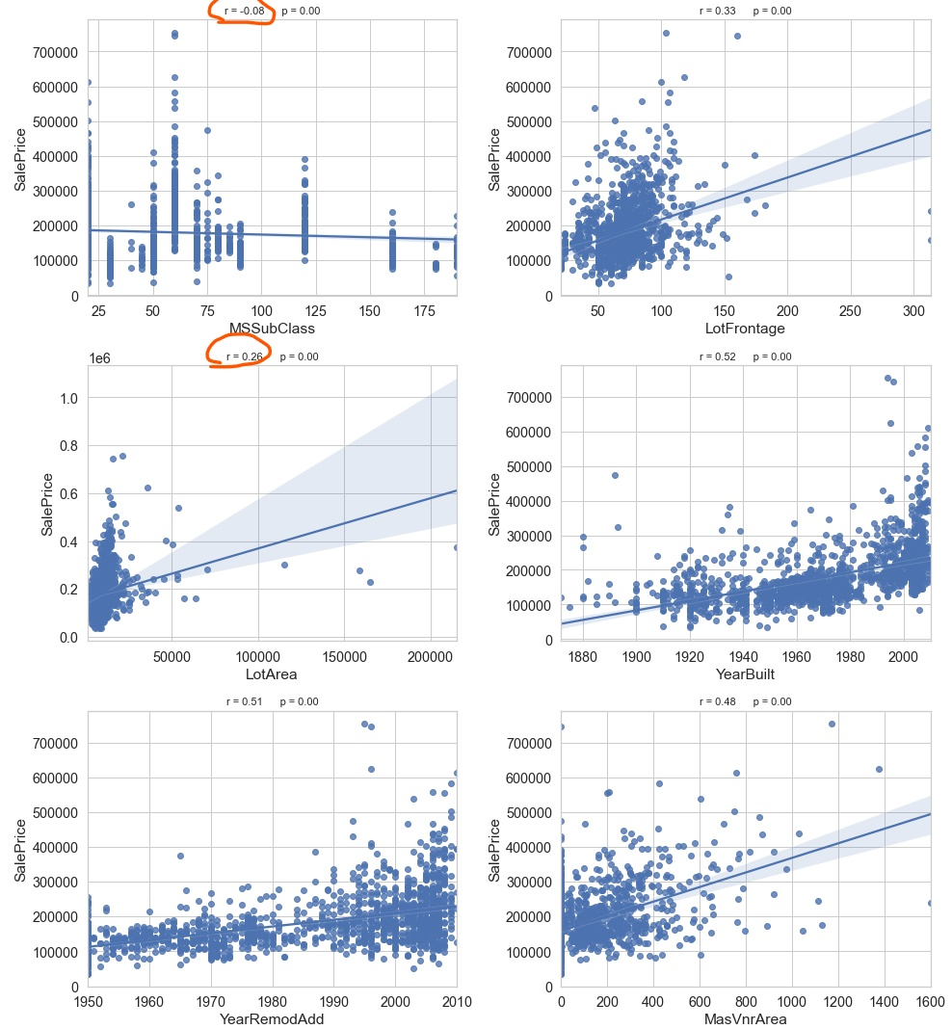
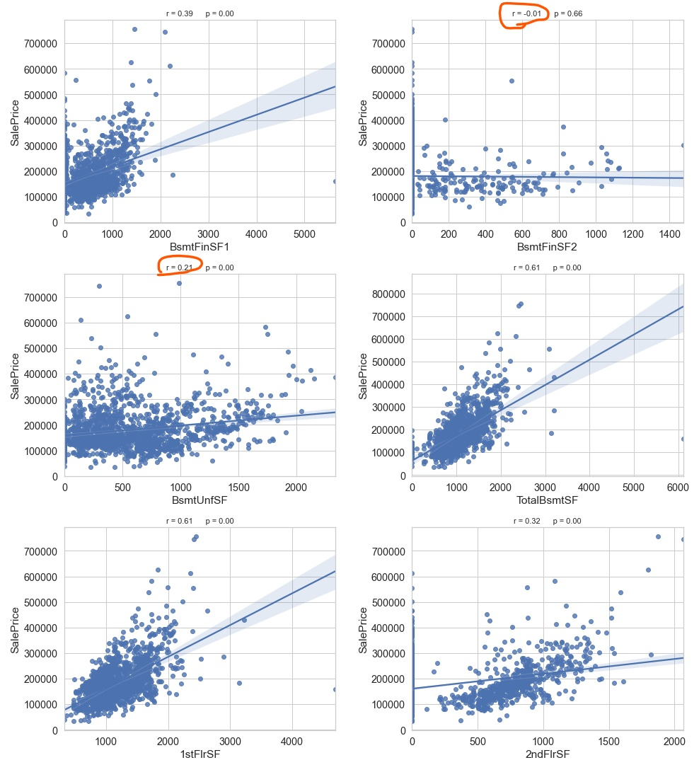
Relation of Numerical Features to Target

Slide 12
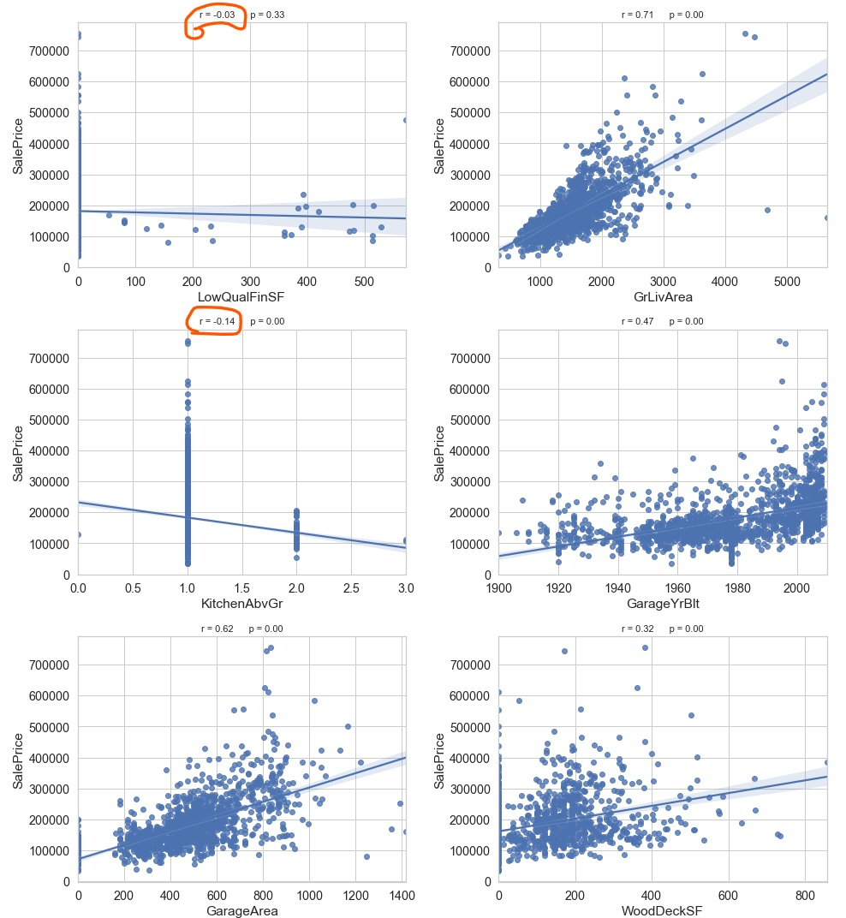
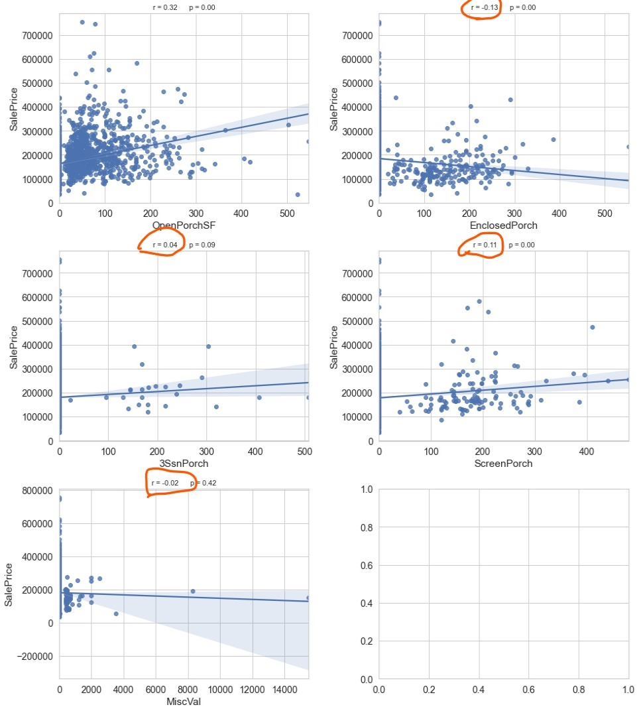
Relation of Numerical Features to Target
These following variables having LOW CORRELATION with the target variable are dropped: MSSubClass, LotArea, BsmtFinSF2, BsmtUnfSF, MiscVal LowQualFinSF, KitchenAbvGr, EnclosedPorch, 3SsnPorch , ScreenPorch

Slide 13
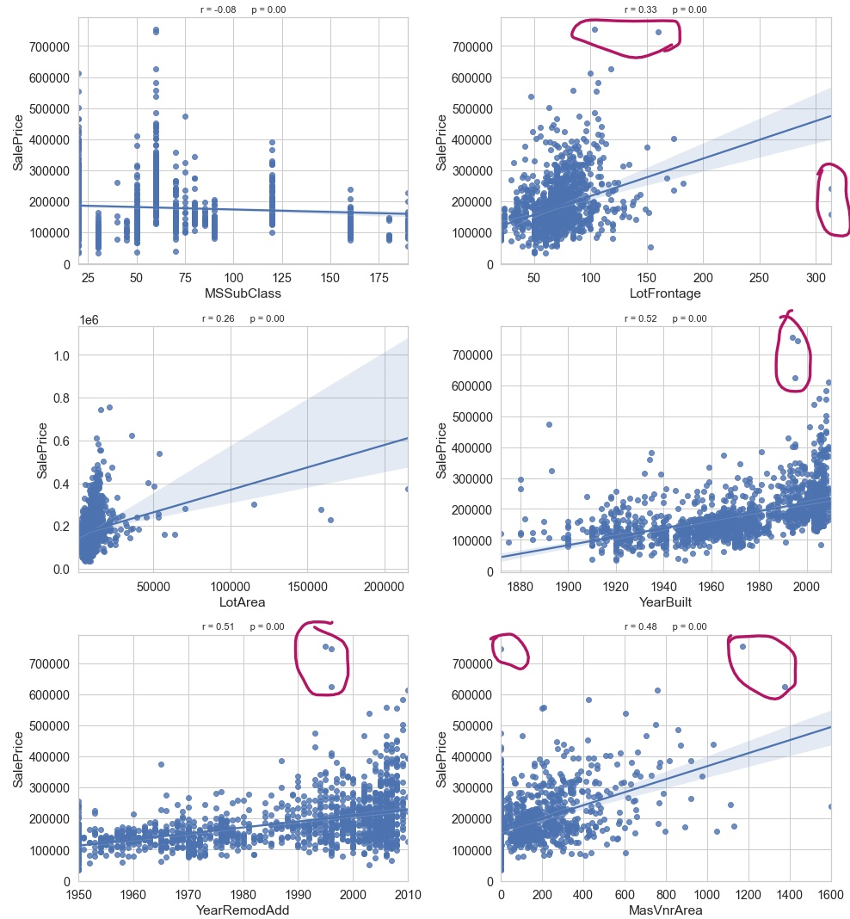
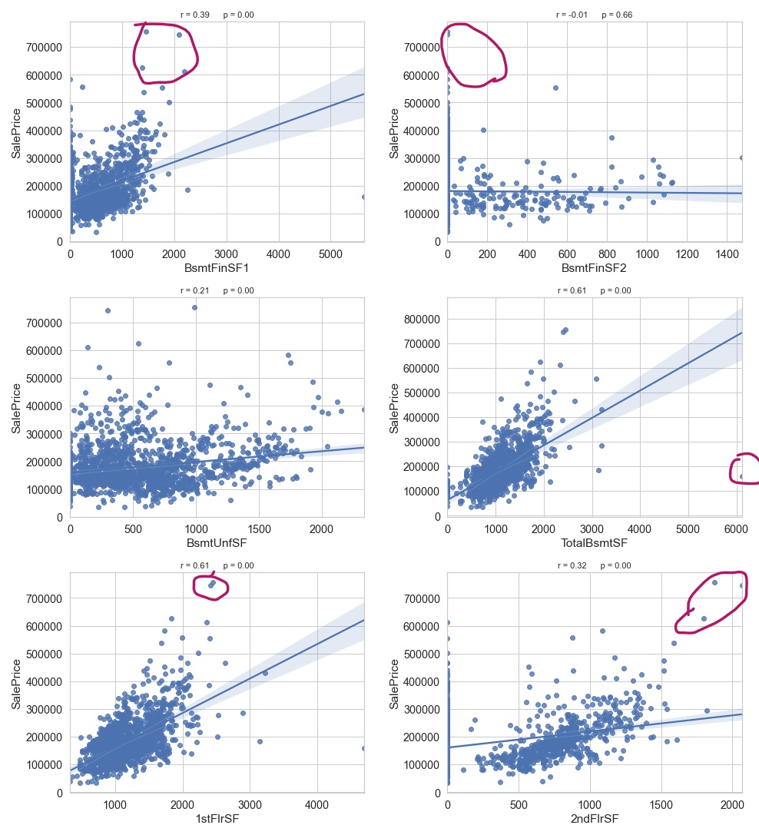
Scatter Plot: To check Outlier in Numerical Features

Slide 14

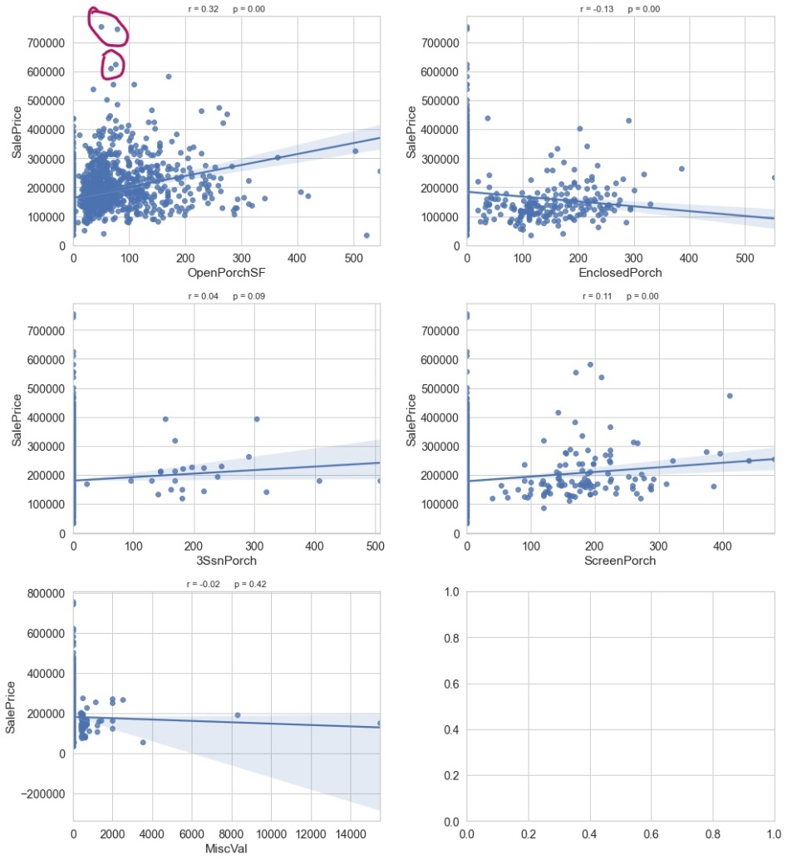
Scatter Plot: To check Outlier in Numerical Features
We have dropped some of observation based on the information from the scatter plots

Slide 15
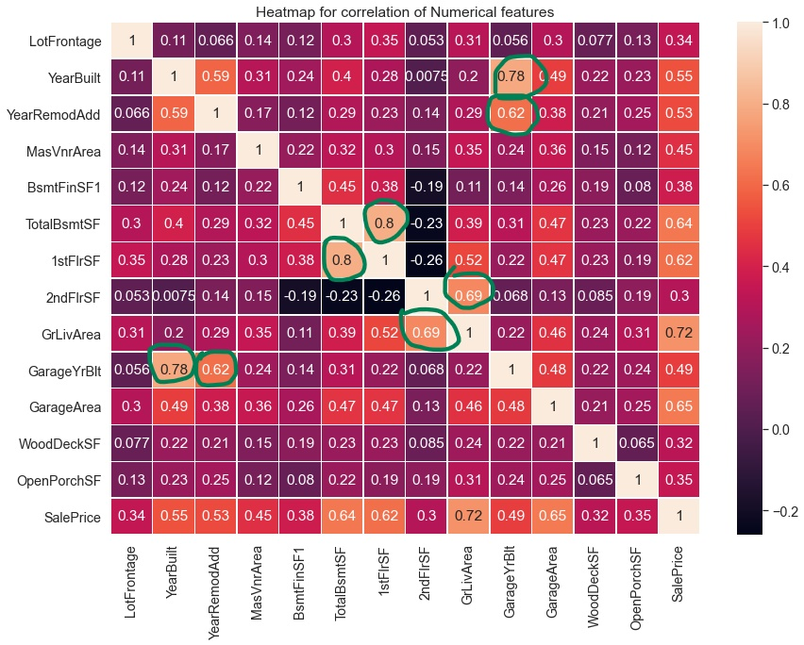
Multi Co-linearity of Numerical Features
From the Correlation Chart we found the Following Multicolinearities between Variables
YearBuilt - GarageArea 1stFlrSF - TotalBsmtSF
2ndFlrSF - GrLivArea GarageYrBlt - YearRemodAdd
Hence we had dropped the following variables
YearBuilt, 1stFlrSF, 2ndFlrSF, GarageYrBlt

Slide 16
Exploration of Categorical Features

Slide 17
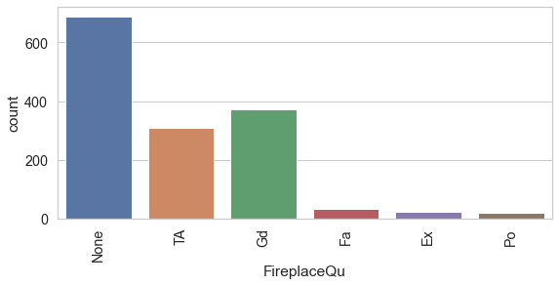
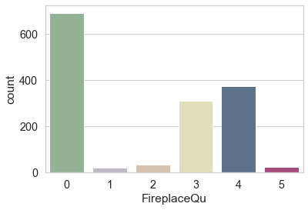
Encoding of Categorical Variables
Encoding Ordinal categories features:
There are some categorical features are ordinal in type.
We have to encode them based on their order value.
Before
After
The Remaining all categorical variables are converted to numerical values using Label Encoder function

Slide 18
Modelling - Machine Learning Algorithms
Train Test split | 80 : 20
Train Set Size:
Explonatery Variable: X | (1156, 56),
Target: Y | (1156,)
Test Set Size:
Explonatery Variable: X | (289,56)
Target: y | (289,)
Scaling: | Standard Scalar
To scale the explanatory train and test datasets

Slide 19
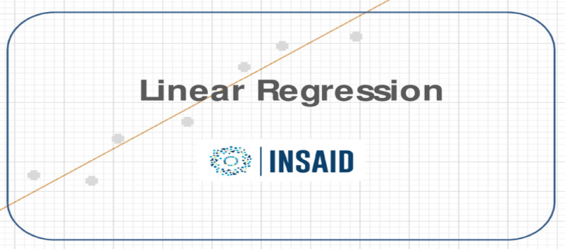

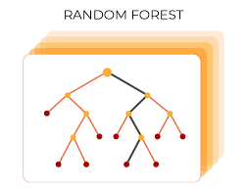
Regression Algorithms for Modelling
Models are evaluated the model using RMSE, R-Squared and Adjusted R-Squared

Slide 20
Model Evaluation Performance of different Regression Algorithms
Algorithm | RMSE |  | R-Squared |  | Adjusted R-Squared
 | Train Set | Test Set | Train Set | Test Set | Train Set | Test Set
Linear Regression | 0.125 | 0.121 | 0.899 | 0.888 | 0.895 | 0.862
Decision Tree Regressor | 0.000 | 0.202 | 1.0 | 0.692 | 1.000 | 0.617
Random Forest Regressor | 0.052 | 0.134 | 0.983 | 0.864 | 0.982 | 0.831
Decision Tree Regressor with GridsearchCV | 0.112 | 0.176 | 0.919 | 0.765 | 0.916 | 0.709
Random forest with RandomizedsearchCV | 0.152 | 0.168 | 0.852 | 0.786 | 0.845 | 0.734
Comparison of Performance Parameters

Slide 21

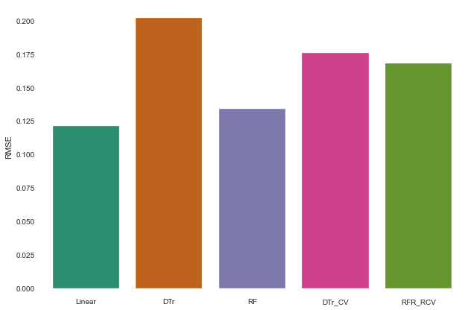
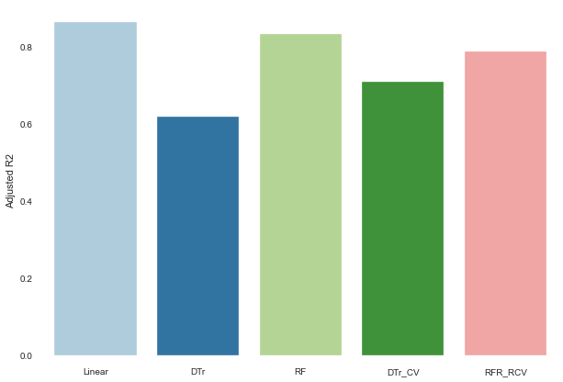
Comparison Plots
RMSE
Adjusted R-Squared

Slide 22
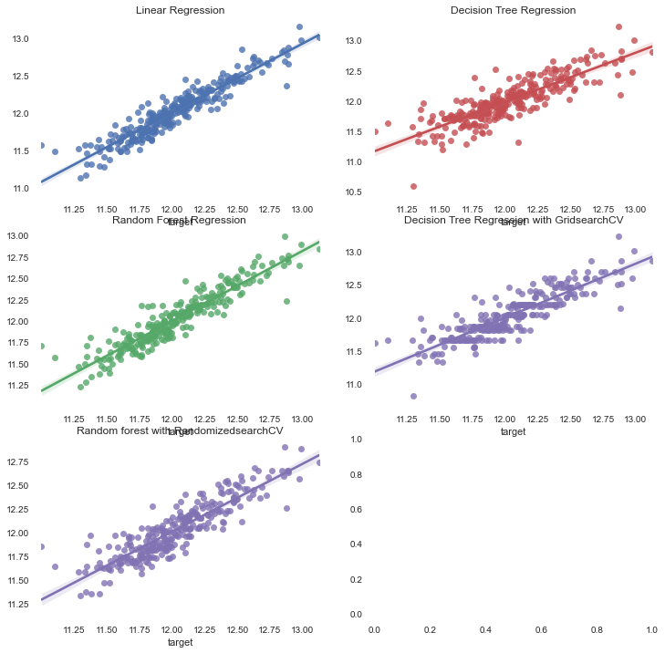
Plotting Predictions

Slide 23
Conclusion
The main contribution is to find out the best algorithm for the prediction of Sale Price of house from the datasets.
We have compared the performance of these models using RMSE and Adjusted R-Squared model evaluation techniques.
We found that the Linear Regression algorithm have performed with the Lowest RMSE and highest Adjusted R-Squared value.

Slide 24

Thank You

